Slide 1

Weekly Connect Airsim + VINS
Ritvik Pandey
Intern (H402743)

Slide 2
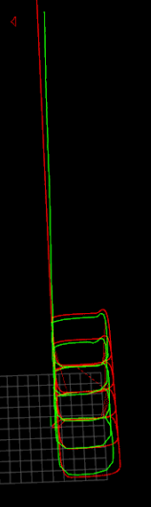
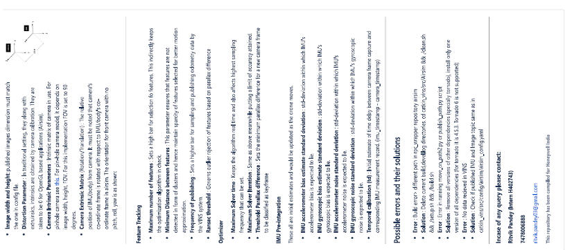
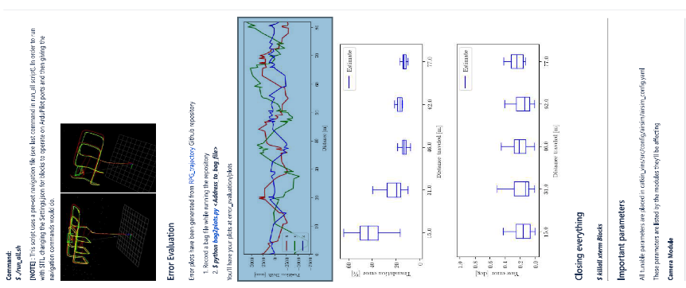
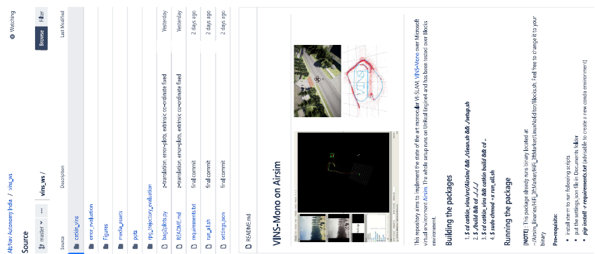
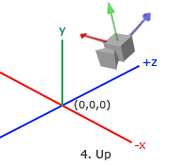
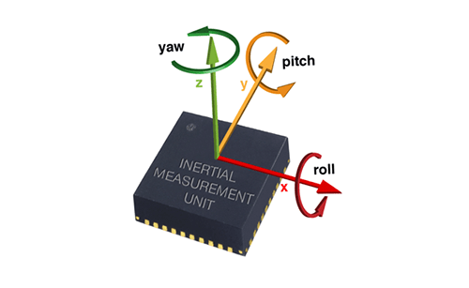
agenda
Code Cleanup and Documentation
Bitbucket Link
Minor improvement with parameter tuning
IMU bias and noise std deviations
Camera Tilt experimentation
Giving a pitch of -45 degrees for better feature capture
2.5m

Slide 3

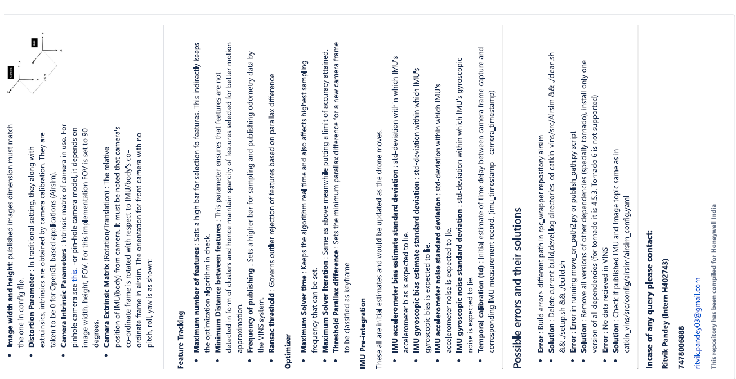

Code Clean up and Documentation
Repository contains:
Instructions to build the package
How to run a demo application (single script)
How to generate error plots (single script)
Details about important parameters and where to find them
Possible errors and their solution
Changes to run with SITL

Slide 4
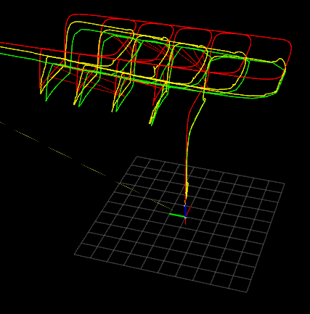
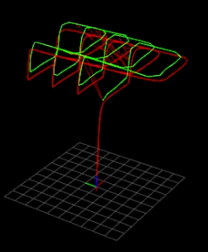
Minor Improvement
Final drift: 5m less than previous
Yaw error: Less than 1 degree now.
Tweaks made:
I am yet to dive into code and extract true IMU values but these are the final tweaks with those 4 parameters.
IMU accelerometer bias estimate standard deviation
IMU gyroscopic bias estimate standard deviation
IMU accelerometer noise standard deviation
IMU gyroscopic noise standard deviation
Previous
Current
[Video]

Slide 5
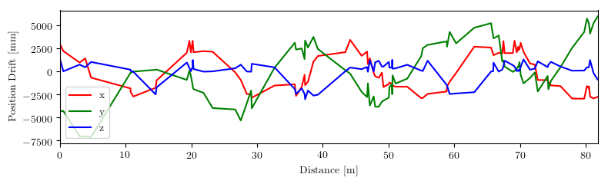
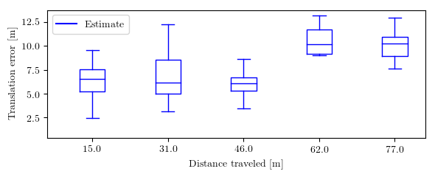
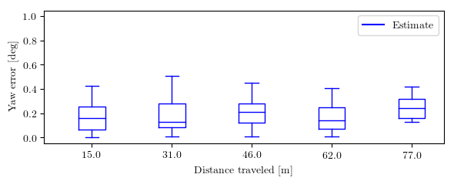
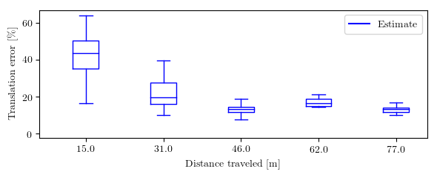
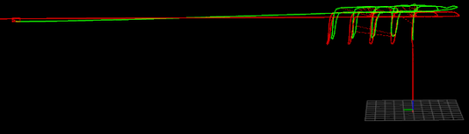
Minor Improvement
Final drift: 5m less than previous
Yaw error: Less than 1 degree now.

Slide 6
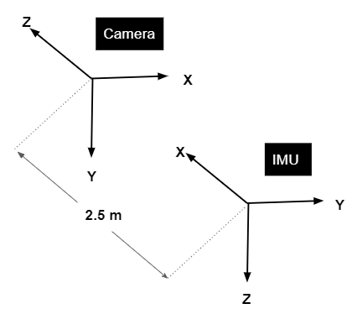
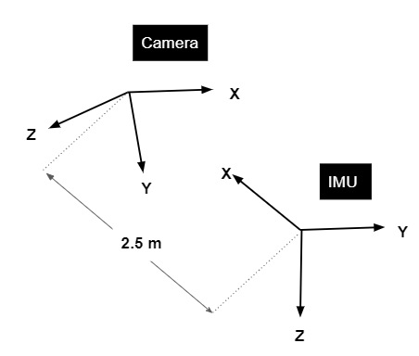
Camera with a PItch
Standard front camera with no pitch
Front camera with -45 degree pitch
-45 degree pitch for better feature capture.
Airsim settings file
Extrinsic rotation as well as translational matrix (changed co-ordinatre frame wrt camera)
Would upload as a separate branch in the repository
2.5m
Will be completed by tonight. Would share it as soon as possible

Slide 7
Thanking you

